Slide 1
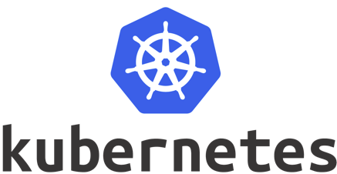
Intro
Notes:
16:9 oranda hazırlıyoruz sunumları. Sinematik olsun ☺ Eğitim başlığı ortalanıyor sayfa ortasına. 36pt

Slide 2
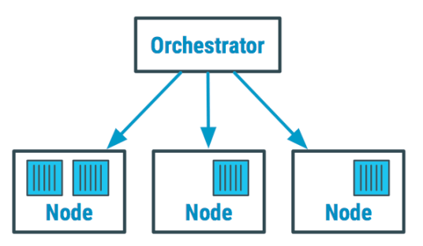
What is Kubernetes?
Open source container orchestration tool.
Originally developed by Google and later on open sourced.
Notes:
Yazım örneği 1. Metinleri sola dayalı yazıyoruz. Metinler dikdörtgene ortalanmış olmalı.

Slide 3
What is Kubernetes?
Kubernetes helps us to manage containers in different environmens.
Physical Machines
Virtual Machines
Public Cloud
Private Cloud
Notes:
Yazım örneği 1. Metinleri sola dayalı yazıyoruz. Metinler dikdörtgene ortalanmış olmalı.

Slide 4

Why Kubernetes?
In a production environment, you need to manage the containers that run the applications and ensure that there is no downtime.
For example, if a container goes down, another container needs to start. Wouldn't it be easier if this behavior was handled by the system?
Rolling update, update a running application without any downtime and without losing requests.
Enjoy your coffee.
Kubernetes handles it!
Notes:
Yazım örneği 1. Metinleri sola dayalı yazıyoruz. Metinler dikdörtgene ortalanmış olmalı.

Slide 5

Benefits of Kubernetes
Continuous development, integration, and deployment
Storage orchestration
Automated rollouts and rollbacks
Automatic bin packing
Self-healing
Secret and configuration management
Source: https://kubernetes.io/docs/concepts/overview/what-is-kubernetes/
Notes:
Yazım örneği 1. Metinleri sola dayalı yazıyoruz. Metinler dikdörtgene ortalanmış olmalı.

Slide 6
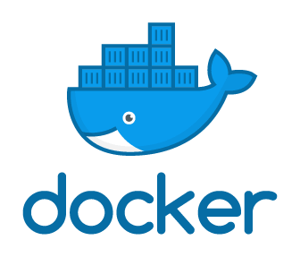
Kubernetes Architecture
Master Node-1
Master Node-2
kube-apiserver
etcd
Control Plane Components
kube-scheduler
kube-controller-manager
cloud-controller-manager
Node Components
Worker Node-1
Worker Node-2
Worker Node-3
Worker Node-4
Worker Node-5
Worker Node-6
kubelet
kube-proxy
Container runtime
Notes:
Yazım örneği 1. Metinleri sola dayalı yazıyoruz. Metinler dikdörtgene ortalanmış olmalı.

Slide 7
Kube Api Server
Master Node-1
Master Node-2
cli
ui
Entry point to cluster
kube-apiserver
api
Worker Node-1
Worker Node-2
Worker Node-3
Worker Node-4
Worker Node-5
Worker Node-6
kubelet
kube-proxy
Container runtime
Notes:
Yazım örneği 1. Metinleri sola dayalı yazıyoruz. Metinler dikdörtgene ortalanmış olmalı.

Slide 8
Control Manager
Master Node-1
Master Node-2
Keeps track what is happening
kube-controller-manager
Worker Node-1
Worker Node-2
Worker Node-3
Worker Node-4
Worker Node-5
Worker Node-6
kubelet
kube-proxy
Container runtime
Notes:
Yazım örneği 1. Metinleri sola dayalı yazıyoruz. Metinler dikdörtgene ortalanmış olmalı.

Slide 9
Scheduler
Master Node-1
Master Node-2
Pods placement
kube-scheduler
Worker Node-1
Worker Node-2
Worker Node-3
Worker Node-4
Worker Node-5
Worker Node-6
kubelet
kube-proxy
Container runtime
Notes:
Yazım örneği 1. Metinleri sola dayalı yazıyoruz. Metinler dikdörtgene ortalanmış olmalı.

Slide 10
Master Node-1
Master Node-2
Virtual Network
Worker Node-1
Worker Node-2
Worker Node-3
Worker Node-4
Worker Node-5
Worker Node-6
Notes:
Yazım örneği 1. Metinleri sola dayalı yazıyoruz. Metinler dikdörtgene ortalanmış olmalı.

Slide 11

etcd
Master Node-1
Master Node-2
Kubernetes backing store
etcd
Worker Node-1
Worker Node-2
Worker Node-3
Worker Node-4
Worker Node-5
Worker Node-6
kubelet
kube-proxy
Container runtime
Notes:
Yazım örneği 1. Metinleri sola dayalı yazıyoruz. Metinler dikdörtgene ortalanmış olmalı.

Slide 12
Node Components
kubelet: Primary "node agent" that runs on each node. Captain of the node on be half of the k8s.
kube-Proxy: Process runs on each node. Lat the pods communicate in node with services.
container runtime: Docker
Notes:
Yazım örneği 1. Metinleri sola dayalı yazıyoruz. Metinler dikdörtgene ortalanmış olmalı.

Slide 13
Kubernetes Objects - Pod
Worker Node-1
Worker Node-2
Worker Node-2
Smallest unif of K8s
Abstraction over container
Usually contains one container/application
If there are more usually second container auxiliary
Each pod have an ip
my-app-1
my-app-3
my-app-1
ip
ip
ip
my-app-2
my-app-2
my-app-3
ip
ip
ip
Notes:
Yazım örneği 1. Metinleri sola dayalı yazıyoruz. Metinler dikdörtgene ortalanmış olmalı.

Slide 14
Kubernetes Objects - Service
Worker Node-1
Once pod dies it is re-created with different ip
Service makes sure when pod get re-created takes the same ip
my-app-1
service
ip
my-app-2
service
ip
Notes:
Yazım örneği 1. Metinleri sola dayalı yazıyoruz. Metinler dikdörtgene ortalanmış olmalı.

Slide 15
Kubernetes Objects - Ingress
Worker Node-1
Ingress exposes the apps to outside world.
ingress
my-app-1
service
ip
my-app-2
service
ip
Notes:
Yazım örneği 1. Metinleri sola dayalı yazıyoruz. Metinler dikdörtgene ortalanmış olmalı.

Slide 16
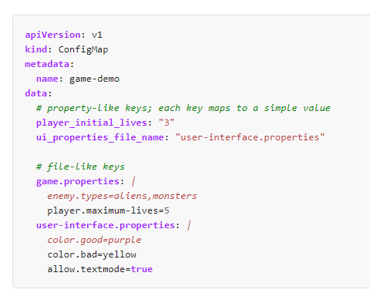
Kubernetes Objects - ConfigMap
Worker Node-1
ConfigMap
A ConfigMap is an API object used to store non-confidential data in key-value pairs.
Pods can consume ConfigMaps as environment variables, command-line arguments, or as configuration files in a volume.
Prevents us rebuild, re-create object even slight changes such as database url.
ingress
my-app-1
service
my-app-2
service
Notes:
Yazım örneği 1. Metinleri sola dayalı yazıyoruz. Metinler dikdörtgene ortalanmış olmalı.

Slide 17
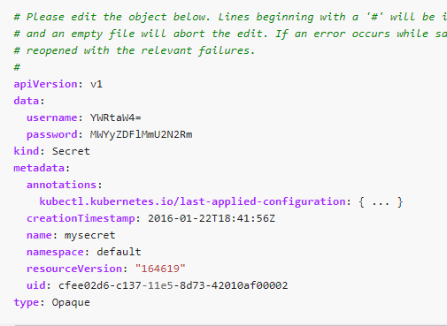
Kubernetes Objects - Secrets
Worker Node-1
Secrets
Kubernetes Secrets let you store and manage sensitive information, such as passwords, OAuth tokens, and ssh keys.
Storing confidential information in a Secret is safer and more flexible than putting it verbatim in a Pod definition or in a container image.
ingress
ConfigMap
my-app-1
service
my-app-2
service
Notes:
Yazım örneği 1. Metinleri sola dayalı yazıyoruz. Metinler dikdörtgene ortalanmış olmalı.

Slide 18
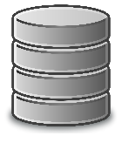

Kubernetes Objects - Volumes
Worker Node-1
When a Container crashes, kubelet will restart it, but the files will be lost.
The Kubernetes Volume abstraction solves both of these problems.
At its core, a volume is just a directory, possibly with some data in it, which is accessible to the Containers in a Pod.
Storage can be local or remote.
K8s cluster doesn’t manage persistent storage, just use available ones.
my-app-1
database
volume
Notes:
Yazım örneği 1. Metinleri sola dayalı yazıyoruz. Metinler dikdörtgene ortalanmış olmalı.

Slide 19
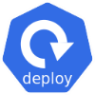
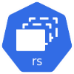
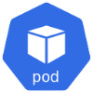
Kubernetes Objects - Deployment
Worker Node-1
Worker Node-2
Abstraction of pods
We do use deployments not Pods in general
my-app-1
my-app-2
my-app-3
service
database
Notes:
Yazım örneği 1. Metinleri sola dayalı yazıyoruz. Metinler dikdörtgene ortalanmış olmalı.

Slide 20
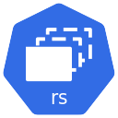
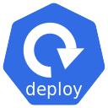
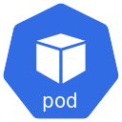
Kubernetes Objects - Deployment
apiVersion: apps/v1
kind: Deployment
metadata:
name: nginx-deployment
labels:
app: nginx
spec:
replicas: 3
selector:
matchLabels:
app: nginx
template:
metadata:
labels:
app: nginx
spec:
containers:
- name: nginx
image: nginx:1.14.2
ports:
- containerPort: 80
Notes:
Yazım örneği 1. Metinleri sola dayalı yazıyoruz. Metinler dikdörtgene ortalanmış olmalı.

Slide 21
Managed Kubernetes
According to 451 Research, 76% of enterprises will standardize on Kubernetes within the
next 3 years because it promises a consistent set of capabilities across any infrastructure -
from datacenter to cloud to the edge.1
Google Kubernetes Engine (GKE)
Amazon Elastic Container Service (EKS) for Kubernetes
Azure Kubernetes Service (AKS)
DigitalOcean (DO)
Platform9
OpenShift
IBM Cloud Kubernetes service
Alibaba Cloud
Rancher
VMware Tanzu
1. “Kubernetes and Beyond – Effective Implementation of Cloud Native Software in the Enterprise” by Jay
Lyman, Principal Analyst 451 Research – Download Whitepaper
Notes:
Yazım örneği 1. Metinleri sola dayalı yazıyoruz. Metinler dikdörtgene ortalanmış olmalı.

Slide 22
Why Managed Kubernetes
Vanilla Kubernetes installations are plagued by a lack of central visibility, inconsistent security practices and complex management processes. Therefore, Kubernetes management platforms are adopted by enterprises to deliver:
Simplified Cluster Operations: improved DevOps efficiencies with simplified cluster operations
Consistent Security Policy & User Management: best practice security policy enforcement and advanced user management on any infrastructure
Access to Shared Tools & Services: a high level of reliability with easy, consistent access to shared tools and services
Notes:
Yazım örneği 1. Metinleri sola dayalı yazıyoruz. Metinler dikdörtgene ortalanmış olmalı.

Slide 23
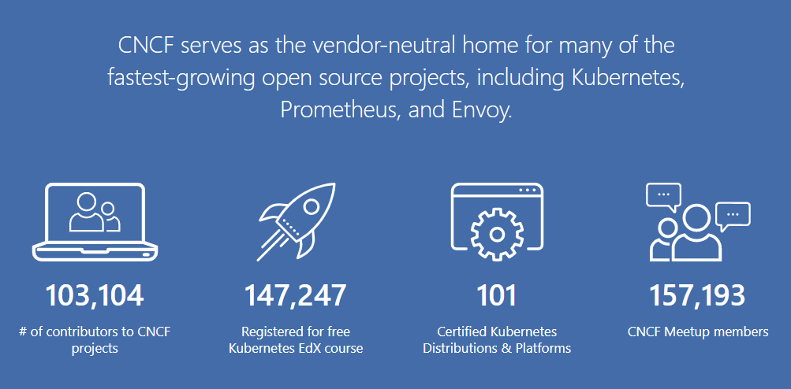
Cloud Native Computing Foundation (CNCF)
Notes:
Yazım örneği 1. Metinleri sola dayalı yazıyoruz. Metinler dikdörtgene ortalanmış olmalı.

Slide 24
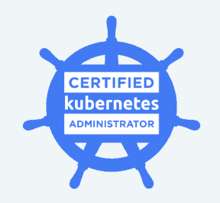
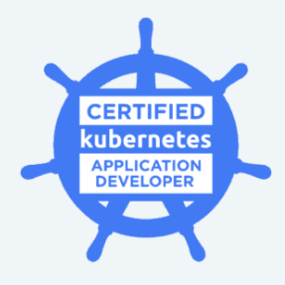
Cloud Native Computing Foundation (CNCF)
Certifications
Notes:
Yazım örneği 1. Metinleri sola dayalı yazıyoruz. Metinler dikdörtgene ortalanmış olmalı.

